Slide 1
CS 551
Spring 2025

Slide 2
Structs part 2

Slide 4
This is a derived trait it will allow instances of Rectangle to be formatted with {:?}

Slide 5
https://doc.rust-lang.org/reference/attributes/derive.html

Slide 6
Structs in Rust are a bit more robust than in C
You can emulate a lot of object oriented style idioms in Rust
Functions can be implemented on different types (e.g., structs)
This is per “instance”
You can also associate a function with the overall type
E.g., String::from()

Slide 7
Structs in Rust are a bit more robust than in C
You can emulate a lot of object oriented style idioms in Rust
Functions can be implemented on different types (e.g., structs)
This is per “instance”
You can also associate a function with the overall type
E.g., String::from()

Slide 8
Structs in Rust are a bit more robust than in C
You can emulate a lot of object oriented style idioms in Rust
Functions can be implemented on different types (e.g., structs)
This is per “instance”
You can also associate a function with the overall type
E.g., String::from()

Slide 10
To specify functions that should can be called on instances of a struct, we use the impl keyword

Slide 11
The first parameter is always &self
Why?

Slide 12
The first parameter is always &self

Slide 13
What would happen to “self” if we didn’t borrow?

Slide 14
What if we wanted a function (method) that can change “self”

Slide 15
Need to mark it mut

Slide 17
Structs in Rust are a bit more robust than in C
You can emulate a lot of object oriented style idioms in Rust
Functions can be implemented on different types (e.g., structs)
This is per “instance”
You can also associate a function with the overall type
E.g., String::from()

Slide 18
Structs in Rust are a bit more robust than in C
You can emulate a lot of object oriented style idioms in Rust
Functions can be implemented on different types (e.g., structs)
This is per “instance”
You can also associate a function with the overall type
E.g., String::from()

Slide 19
We can also mark a function associated with a struct, but not a particular instance of a struct

Slide 20
We just don’t have self as the first parameter

Slide 22
Things don’t have to be in a single impl block!

Slide 24
Let’s try making a linked list…
We are just going to store u32s
How would we do it in C?
A Node struct that has two fields:
A u32
A pointer to the next node in the list (or null)

Slide 25
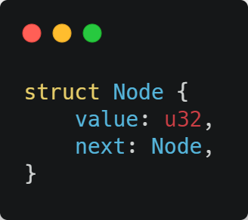

Slide 26
Will it compile?

Slide 27
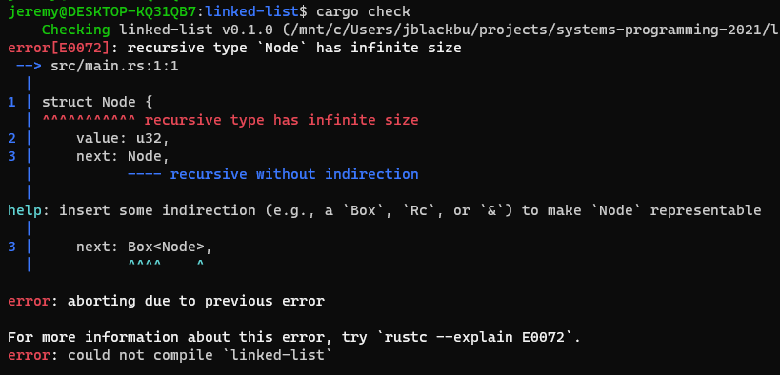

Slide 28
Uhhhhh
Remember that Rust does heavy static analysis
E.g., everything is checked at compile time!
We need to know how much space a type uses
A recursive type’s size can’t be determined at compile time!
Why?
Well, it’s in the error: it could continue infinitely!

Slide 29
Node
Value: i32
Next:
Node
Value: i32
Next:
u32
Node
Value: i32
Next:
u32
u32
Node
Value: i32
Next:
u32
∞

Slide 30
Smart pointers to the rescue!
Regular pointers are just a value that has an address to some memory
Smart pointers have additional metadata and functionality
We’ve already seen some smart pointers
String
Points to memory, has length
Vec
Has a length and capacity
Both have additional functionality

Slide 31
Three most common smart pointers
Box<T>
Allocates values on the heap
Rc<T>
Reference counting pointer that enables multiple ownership
Ref<T>, RefMut<T>, RefCell<T>
Enforces borrow rules at runtime instead of compile time

Slide 32
Box<T>
For allocating values on the heap
When might we use this?
If we have a type with a size unknown at compile time
Lots of data that we want to transfer ownership of, but want to make sure we don’t copy it
When you care about a value having a certain Trait as opposed to being of a certain type

Slide 33
Storing data on the heap with Box<T>
It’s pretty simple
Box::new(value)
“value” is now on the heap
The box will be automatically deallocated when it goes out of scope!

Slide 35
Recursive Types
Sometimes a type will have a field that refers to another type
I.e., it is recursive
The problem is that the recursion could be “infinite”
The Rust compiler can’t know the size of the type at compile time!

Slide 36
Cons list
An example of a recursive type is a cons list
Cons lists are very common in functional languages
If you’ve ever used a Lisp variant, you know all about cons!
A cons constructs a pair from two arguments
Usually a single value and another pair
The first item in the pair is the value of that element in the list
The second item is the the next element in the list
Hence recursive!

Slide 38
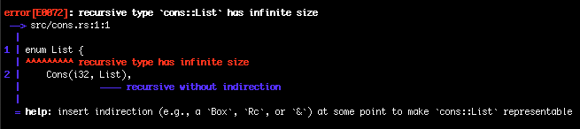

Slide 39
The compiler is giving us several types of solutions!
Box<T> is a pointer which means Rust knows exactly how big it is
In terms of being on the stack!
So, maybe we can make use of this to make the compiler happy…

Slide 40
The compiler is giving us several types of solutions!
Box<T> is a pointer which means Rust knows exactly how big it is
In terms of being on the stack!
So, maybe we can make use of this to make the compiler happy…

Slide 41
The compiler is giving us several types of solutions!
Box<T> is a pointer which means Rust knows exactly how big it is
In terms of being on the stack!
So, maybe we can make use of this to make the compiler happy…

Slide 42
The compiler is giving us several types of solutions!
Box<T> is a pointer which means Rust knows exactly how big it is
In terms of being on the stack!
So, maybe we can make use of this to make the compiler happy…

Slide 45
More on Box<T>
Boxes only provide heap allocation and indirection
There are additional features other smart pointers have
Because of the lack of features, Boxes have barely any overhead
Box<T> is a smart pointer because it implements the Deref trait
Drop trait includes a Drop() function which is automatically called whenever the value goes out of scope
It’s like a destructor
You never have to call it yourself!
There is also a Deref trait that lets us deal with Boxes like they were regular references
Don’t have to manually deref

